Slide 1
Informed search algorithms
Chapter 3

Slide 2
Informed (Heuristic) Search
Idea: be smart about what paths to try.

Slide 3
Blind Search vs. Informed Search
What’s the difference?
How do we formally specify this?
A node is selected for expansion based on an evaluation function that estimates cost to goal.

Slide 4
General Tree Search Paradigm
function tree-search(root-node) fringe ← successors(root-node) while ( notempty(fringe) )
{node ← remove-first(fringe) //lowest f value state ← state(node)
if goal-test(state) return solution(node)
fringe ← insert-all(successors(node),fringe) } return failure
end tree-search

Slide 5
General Graph Search Paradigm
function tree-search(root-node) fringe ← successors(root-node) explored ← empty
while ( notempty(fringe) )
{node ← remove-first(fringe) state ← state(node)
if goal-test(state) return solution(node) explored ← insert(node,explored)
fringe ← insert-all(successors(node),fringe, if node not in explored)
}
return failure end tree-search

Slide 6
Best-First Search
Use an evaluation function f(n) for node n.
Always choose the node from fringe that has the lowest f value.
3
5
1
4
6

Slide 7
Best-first search
A search strategy is defined by picking the order of node expansion
Idea: use an evaluation function f(n) for each node
estimate of "desirability“
→ Expand most desirable unexpanded node
Implementation:
Order the nodes in fringe in decreasing order of desirability
Special cases:
greedy best-first search
A* search

Slide 8
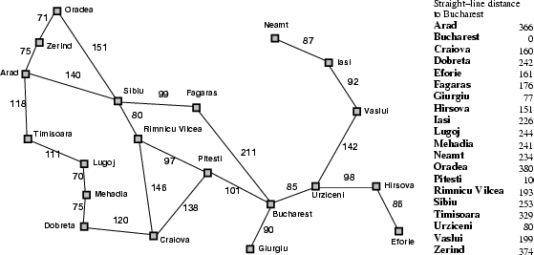
Romania with step costs in km

Slide 9
Old (Uninformed) Friends
Breadth First =
Best First
with f(n) = depth(n)
Uniform cost search =
Best First
with f(n) = the sum of edge costs from start to n
g(n)
12

Slide 10
Greedy best-first search
Evaluation function f(n) = h(n) (heuristic function)
= estimate of cost from n to goal
e.g., h_{SLD}(n) = straight-line distance from n to Bucharest
Greedy best-first search expands the node that appears to be closest to goal

Slide 11
Properties of greedy best-first search
Complete?
No – can get stuck in loops, e.g., Iasi → Neamt → Iasi →
Neamt →
Time?
O(b^{m}), but a good heuristic can give dramatic improvement
Space?
O(b^{m}) -- keeps all nodes in memory
Optimal?
No

Slide 12
A* search
Idea: avoid expanding paths that are already expensive
Evaluation function f(n) = g(n) + h(n)
g(n) = cost so far to reach n
h(n) = estimated cost from n to goal
f(n) = estimated total cost of path through n to goal

Slide 13
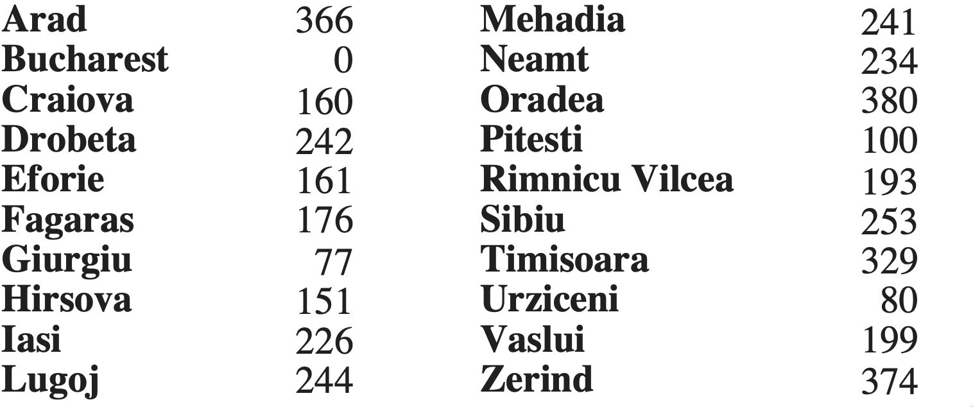
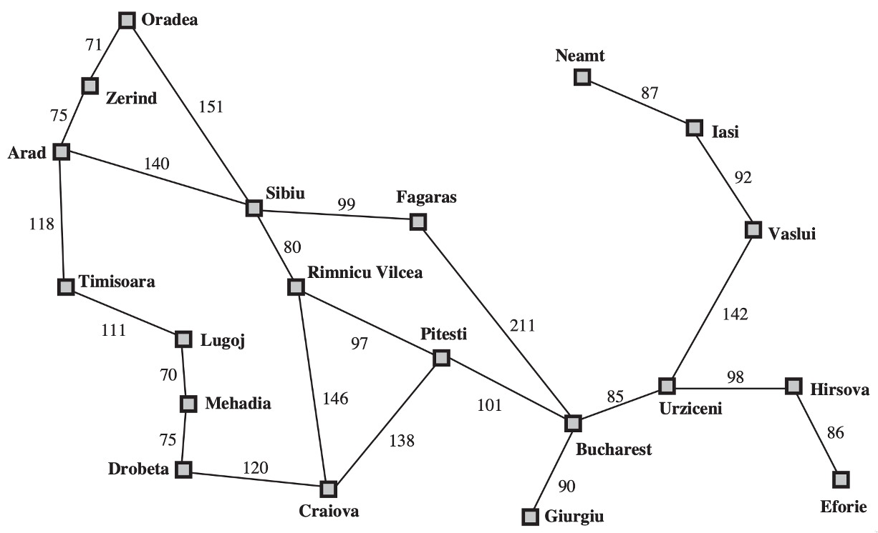
A* for
Romanian Shortest Path
Fig: Values of hSLD —straight-line distances to Bucharest.
16

Slide 14

Romanian Shortest Path
A* for
16

Slide 15
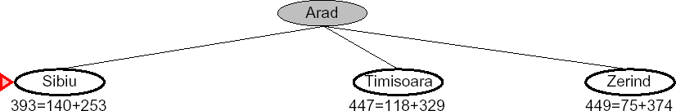

Slide 16
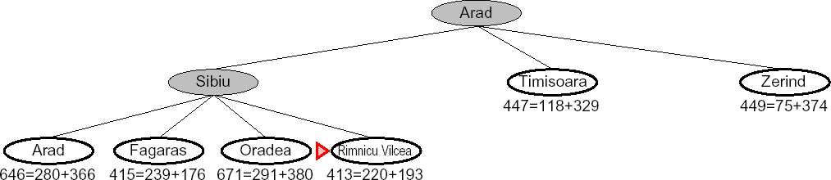

Slide 17
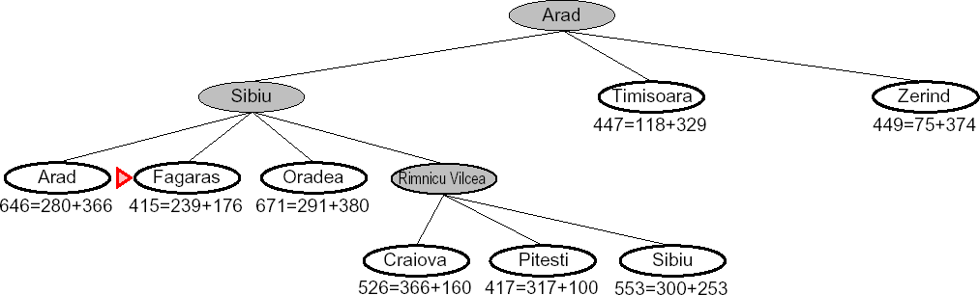

Slide 18
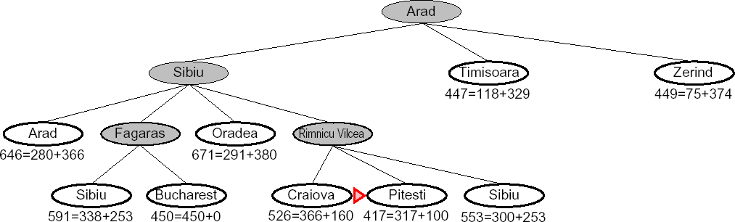

Slide 19
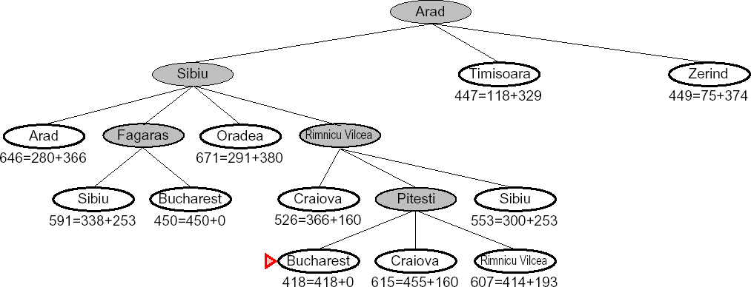

Slide 20
Admissible heuristics
A heuristic function h(n) is admissible if for every node n, h(n) ≤ h*(n),
where h*(n) is the true cost to reach the goal state from n.
An admissible heuristic never overestimates the cost to reach the goal, i.e., it is optimistic
Example: h_{SLD}(n) (never overestimates the actual road distance)
Theorem: If h(n) is admissible, A* using TREE-SEARCH is optimal

Slide 21
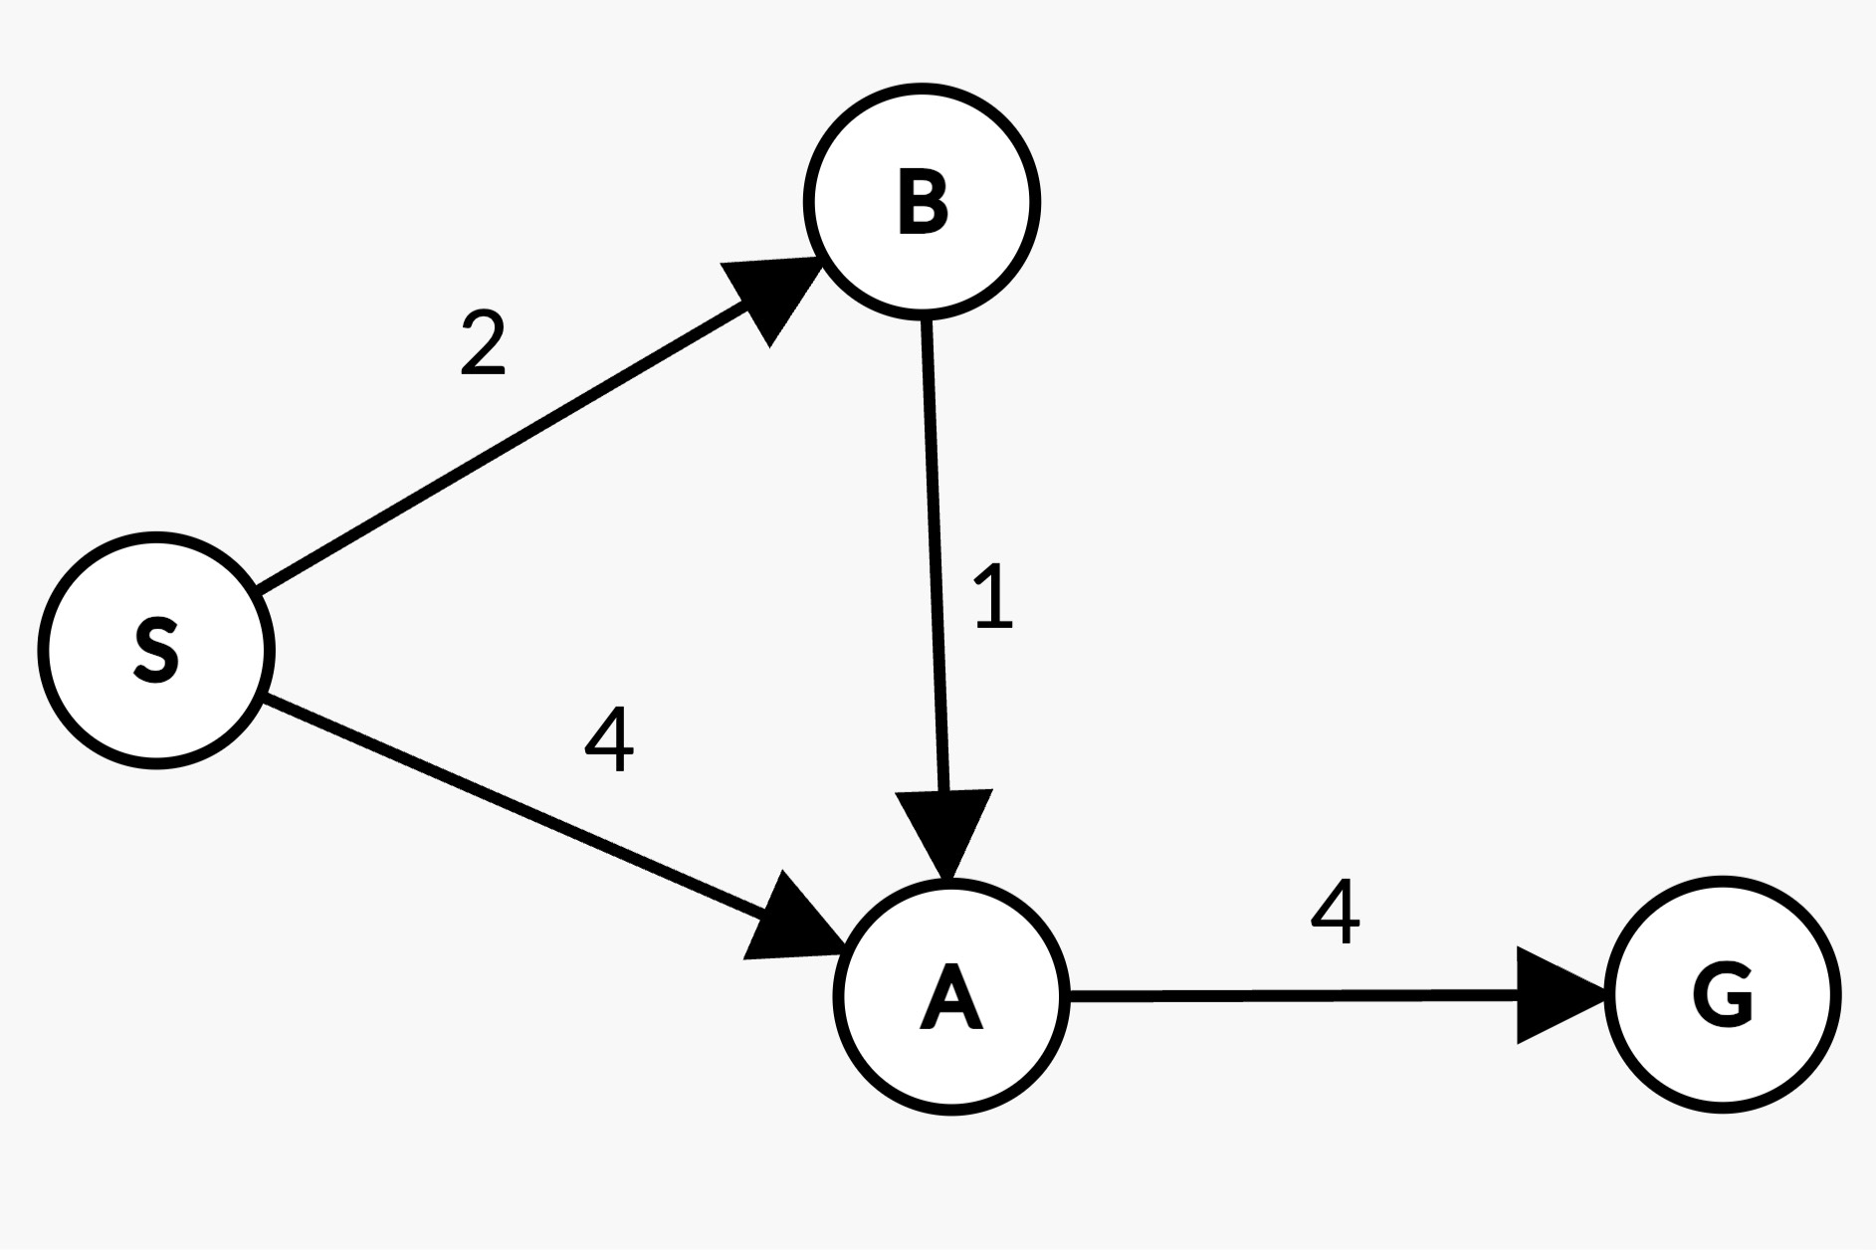


Admissible heuristics – Tree Search
h = 5
h = 7
h = 1
h = 0

Slide 22





Admissible heuristics – Tree Search
h = 5
h = 7
h = 1
h = 0

Slide 23

Admissible heuristics – Tree Search
h = 5
h = 7
h = 1
h = 0

Slide 24


Admissible heuristics – Tree Search
h = 5
h = 7
h = 1
h = 0

Slide 25



Admissible heuristics – Tree Search
h = 5
h = 7
h = 1
h = 0

Slide 26
Consistency of Heuristics
h(n) is consistent if
for every node n
and for every successor s of n
h(n) <= c(n, s) + h(s)
A
1
C
h=4
h=1
Consequences of consistency:
The f value along a path never decreases
h(A) <= c(A, C) + h(C)
A* graph search is optimal
h=2
3
G
Theorem: If h(n) is consistent, A* using GRAPH-SEARCH is optimal

Slide 27

Example – Graph Search
h = 5
h = 7
h = 1
h = 0

Slide 28



Example – Graph Search
h = 5
h = 7
h = 1
h = 0

Slide 29

Example – Graph Search
h = 5
h = 7
h = 1
h = 0

Slide 30


Example – Graph Search
h = 5
h = 7
h = 1
h = 0

Slide 31
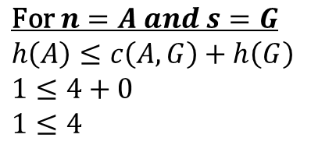
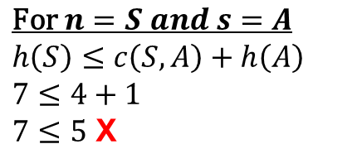
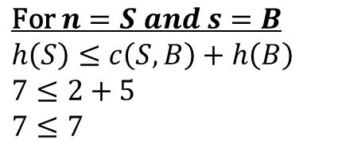
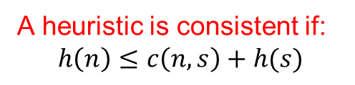



Checking Consistency of a heuristic
A heuristic is consistent if:
$$h\left(n\right)≤c\left(n, s\right)+h(s)$$
h = 5
h = 7
h = 1
h = 0
$$∗n=current node$$
$$s=successor of n$$
$$\text{For} n=S and s=A$$
$$h\left(S\right)≤c\left(S, A\right)+h\left(A\right)$$
$$7≤4+1$$
$7≤5$ X
$$\text{For} n=A and s=G$$
$$h\left(A\right)≤c\left(A, G\right)+h\left(G\right)$$
$$1≤4+0$$
$1≤4$
h(S) and h(B) are not consistent
Therefore, the heuristics is not consistent
Graph search will not guarantee optimal solution
If we set h(S) = 5 and h(B) = 2, the heuristic will be consistent.
Change these values in the graph and perform graph search. You will get the optimal path to the goal.
$$\text{For} n=S and s=B$$
$$h\left(S\right)≤c\left(S, B\right)+h\left(B\right)$$
$$7≤2+5$$
$7≤7$
$$\text{For} n=B and s=A$$
$$h\left(B\right)≤c\left(B, A\right)+h\left(A\right)$$
$$5≤1+1$$
$5≤2$ X

